Slide 1
Information Theory and Coding Module 2
Presented By:
Dr. Saladi Saritha
Associate Professor Grade 1
School of Electronics Engineering
VIT-AP University

Slide 2
Topics
Joint entropy, Conditional entropy, Mutual information, Discrete memoryless channels - BSC, BEC, noise-free channel, Channel with independent I/O, Cascaded channels. Channel Capacity. Kullback–Leibler divergence (Relative Entropy), Cross-Entropy, Jensen–Shannon divergence

Slide 3

Joint entropy
Joint Entropy is a measure of the uncertainty associated with a set of variables.
Joint Entropy of two discrete random variables X and Y with a joint distribution p(x, y) may be defined as:
$$H\left(X,Y\right)=−\sum_{x∈X}{\sum_{y∈Y}{p\left(x,y\right)log⁡p(x,y)}}$$
Properties:
1) The joint entropy of a set of random variables is a nonnegative number. i.e: H(X,Y) ≥ 0.
2) The joint entropy of a set of variables is greater than or equal to the maximum of all of the individual entropies of the variables in the set. i.e: H(X,Y) ≥ max [H(X), H(Y)]
3) The joint entropy of a set of variables is less than or equal to the sum of the individual entropies of the variables in the set. i.e: H(X,Y) ≤ H(X) + H(Y)
Relations to other entropy measures:
Joint entropy is used in the definition of conditional entropy. H(X|Y) = H(X,Y) – H(Y)
t is also used in the definition of mutual information. I(X;Y) = H(X) + H(Y) – H(X,Y)

Slide 4




Conditional entropy
Conditional entropy quantifies the amount of information needed to describe the outcome of a random variable Y given that the value of another random variable X is known.
Entropy of Y given X is written as H(Y|X).
$$H\left(Y|X\right)=−\sum_{x∈}{\sum_{y∈Y}{p\left(x,y\right)log⁡p(y|x)}}$$
$$H\left(Y|X\right)=−\sum_{x∈}{\sum_{y∈Y}{p\left(x,y\right)log⁡\frac{p(x,y)}{p(x)}}}$$
Entropy of X given Y is written as H(X|Y).
$$H\left(X|Y\right)=−\sum_{x∈}{\sum_{y∈Y}{p\left(x,y\right)log⁡p(x|y)}}$$
$$H\left(X|Y\right)=−\sum_{x∈}{\sum_{y∈Y}{p\left(x,y\right)log⁡\frac{p(x,y)}{p(y)}}}$$
NOTE (Bayes’ Theorem:):
$$p\left(x,y\right)=p\left(x | y\right).p\left(y\right)=p\left(y | x\right).p(x)$$

Slide 5
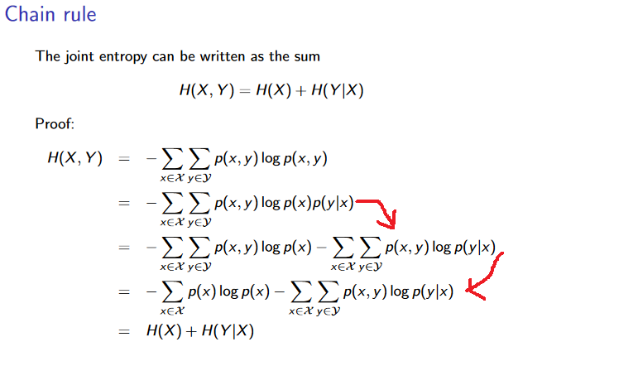
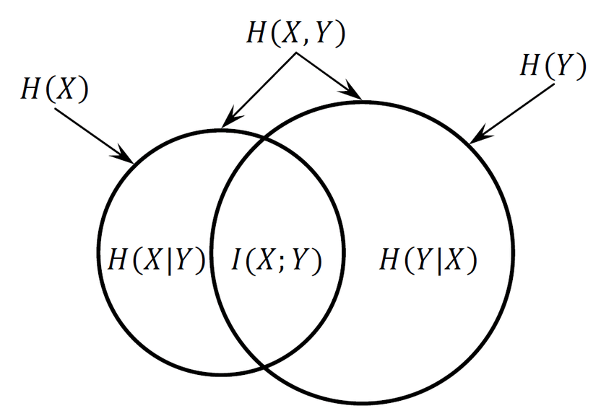
Conditional entropy
Property:
H(Y|X) = 0 iff value of Y is completely determined by value of X.
H(Y|X) = H(Y) and H(X|Y) = H(X) iff Y and X are independent random variables.
chain rule of conditional entropy: H(Y|X) = H(X,Y) - H(X). H(X|Y) = H(X,Y) - H(Y)
H(Y|X) ≤ H(Y)
H(X,Y) = H(Y|X) + H (X|Y) + I(X;Y)
H(X,Y) = H(X) + H (Y) - I(X;Y)

Slide 6
Mutual Information
It is a measure of the mutual dependence between the two variables. More specifically, it quantifies the "amount of information" obtained about one random variable through observing the other random variable.
I(X;Y) = H(X) – H(X|Y) = H(Y) – H(Y|X) b/symbol
Properties:
I(X;Y) = I(Y;X)
I(X;Y) ≥ 0
I(X;Y) = H(X) + H(Y) – H(X,Y)
Prove:
I(X;Y) = I(Y;X)
I(X;Y) ≥ 0

Slide 7
Discrete Memoryless Channel (DMC)
DMC is a statistical model with an input A and an output B.
Channel accept an input symbol A and respond as an output B.
Channel is ‘discrete’ in the sense: Number of symbols in A and B are finite.
Memoryless: Current output only depends on current input not on previous inputs.
P(a_{i}): is assumed to be known.
Each possible input output path can be represented by a conditional probability.: P(b_{j} | a_{i})-----Channel Transmission Probability.
The conditional probabilities that describe an information channel can be represented conveniently using a matrix representation:

Slide 8
Discrete Memoryless Channel (DMC)
P is the channel matrix and for notational convenience we may sometimes rewrite this as
P_{ij} = P(b_{j}/a_{i})
The channel matrix exhibits the following properties and structure:
Each row of P contains the probabilities of all possible outputs from the same input to the channel.
Each column of P contains the probabilities of all possible inputs to a particular output from the channel.
If we transmit the symbol a_{i} we must receive an output symbol with probability 1, that is:
that is, the probability terms in each row must sum to 1.

Slide 9
Discrete Memoryless Channel (DMC)
Noiseless: If the channel is noiseless there will be no error in transmission, the channel matrix is given by
P =[1 0; 0 1]
Noisy: Say the channel is noisy and introduces a bit inversion 1% of the time, then the channel matrix is given by

Slide 10
Binary symmetric channel (BSC)
In BSC the input to the channel will be the binary digits {0, 1}.
channel is assumed memoryless.
Ideally if there is no noise a transmitted 0 is detected by the receiver as a 0, and a transmitted 1 is detected by the receiver as a 1.
The most common effect of noise is to force the detector to detect the wrong bit (bit inversion), that is, a 0 is detected as a 1, and a 1 is detected as a 0.
q = is the probability of error (also called bit error probability, bit error rate (BER), or “crossover” probability)
The BSC is an important channel for digital communication systems as noise present in physical transmission media (fibre optic cable, copper wire, etc.) typically causes bit inversion errors in the receiver.
p = 1-q

Slide 11
Binary erasure channel (BEC)
Another effect that noise (or more usually, loss of signal) may have is to prevent the receiver from deciding whether the symbol was a 0 or a 1.
In this case the output alphabet includes an additional symbol, ? called the “erasure” symbol that denotes a bit that was not able to be detected.
Strictly speaking a BEC does not model the effect of bit inversion; thus a transmitted bit is either received correctly (probability = p) or is received as an “erasure” (probability = q = 1-p ).
A BEC is becoming an increasingly important model for wireless mobile and satellite communication channels, which suffer mainly from dropouts and loss of signal leading to the receiver failing to detect any signal.

Slide 12
BSC: Numerical
For the given binary channel:
Find the channel matrix.
Find P(y1) and P(y2) if P(x1)=P(x2)=0.5
Find the joint probability P(x1, y2), P(x2,y1) when P(x1)=P(x2)=0.5
_{0. 9}
x₁
_{y1}
x₂
_{y2}
_{0. 8}

Slide 13

BEC: Numerical
$$P\left(Y | X\right)=\left[\begin{matrix}1−p & p & 0 \\ 0 & p & 1−p\end{matrix}\right]$$
A Channel has following channel matrix
Draw the channel diagram
If the source has equally likely output, compute the probability associated with the channel output for p = 0.2
BSC: Numerical
For the given BSC.
Show that the mutual information is given by
I(X;Y)=H(Y) + p log₂p + (1-p)log₂(1-p)
2) Calculate I(X;Y) for α = 0.5 and p= 0.1
3) Calculate I(X;Y) for α = 0.5 and p= 0.5, comment on results
_{1-p}
P(x₁ )= α
_{y1}
_{p}
_{p}
_{1-p}
_{y2}
P(x₂ )= 1-α

Slide 14
BSC: Numerical
For the given BSC.
Show that the mutual information is given by
I(X;Y)=H(Y) + p log₂p + (1-p)log₂(1-p)
2) Calculate I(X;Y) for α = 0.5 and p= 0.1
3) Calculate I(X;Y) for α = 0.5 and p= 0.5, comment on results
_{1-p}
P(x₁ )= α
_{y1}
_{p}
_{p}
_{1-p}
_{y2}
P(x₂ )= 1-α

Slide 15
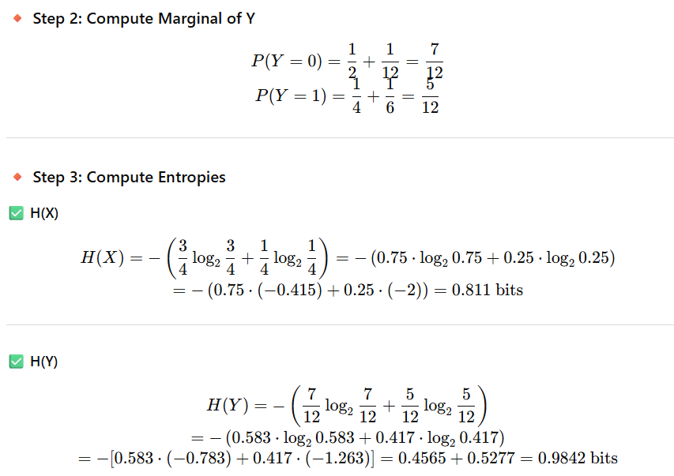
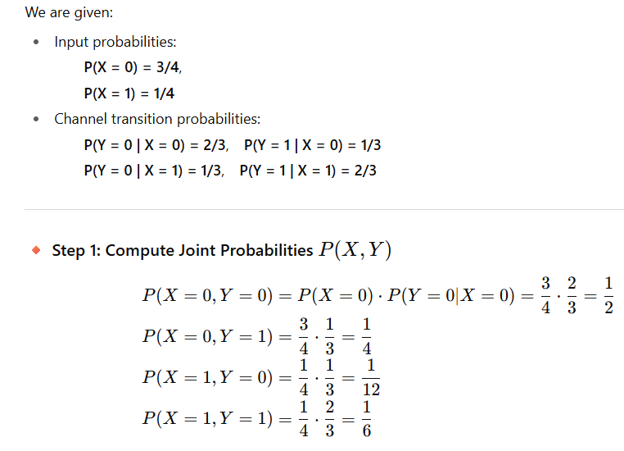
BSC: Numerical
A binary channel has the following noise characteristics:
If the input symbols are transmitted with probabilities ¾ & ¼ respectively, find H(X), H(Y),
H(X,Y), H(Y|X), H(X|Y).

Slide 16
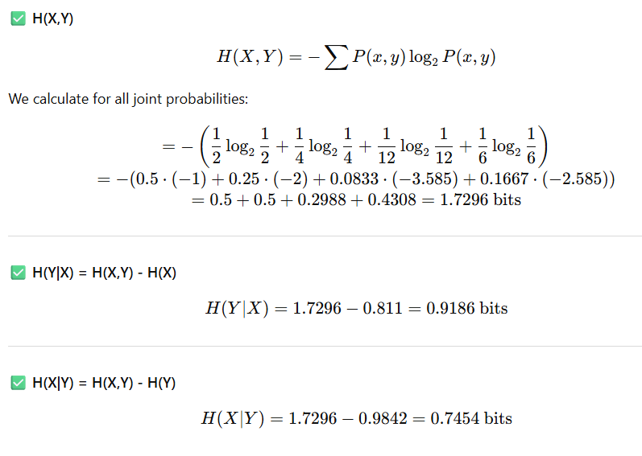

Slide 17
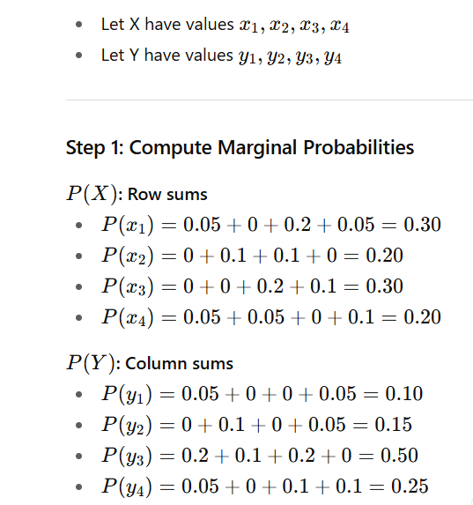
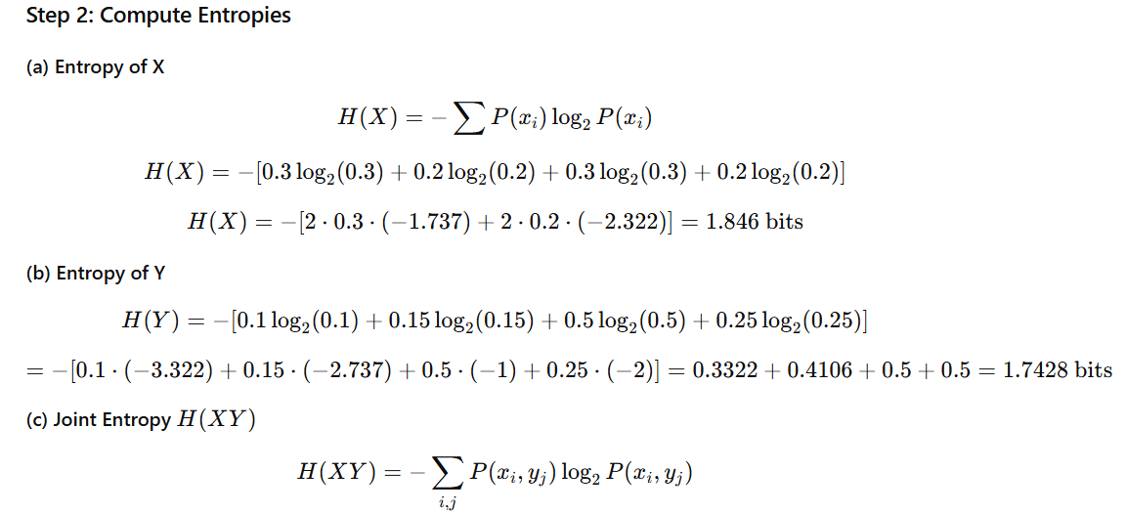
BSC: Numerical
The joint probability matrix for a channel is given. Compute H(X), H(Y), H(XY), H(X/Y) & H(Y/X).

Slide 18
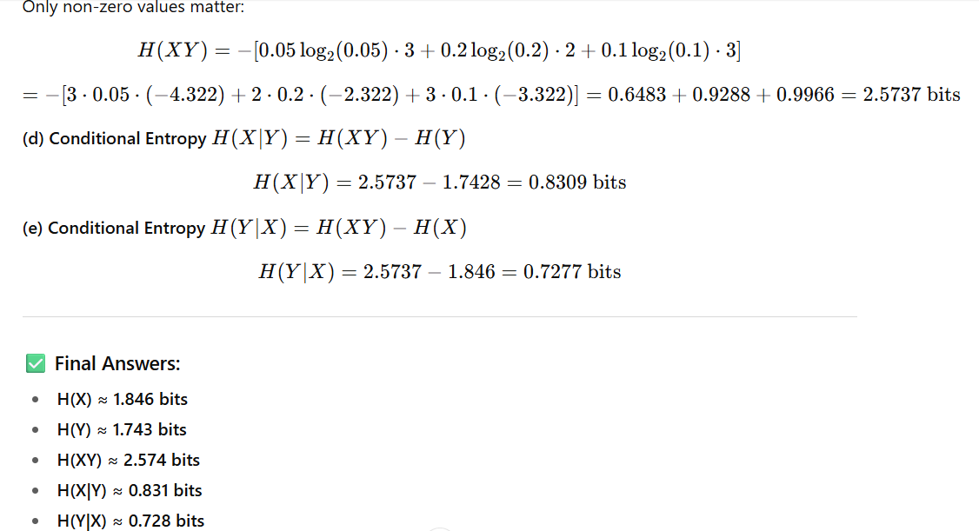

Slide 19
BSC: Numerical
A source delivers the binary digits 0 and 1 with equal probability into a noisy channel at a rate of 1000 digits / second. Owing to noise on the channel the probability of receiving a transmitted ‘0’ as a ‘1’ is 1/16, while the probability of transmitting a ‘1’ and receiving a ‘0’ is 1/32. Determine the rate at which information is received.

Slide 20
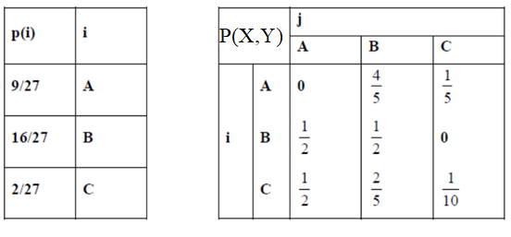
BSC: Numerical
A transmitter produces three symbols ABC which are related with joint probability shown. Calculate H(X,Y)

Slide 21
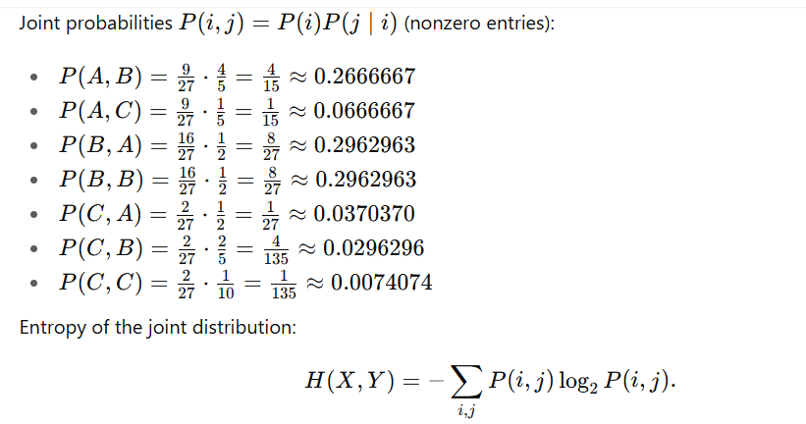
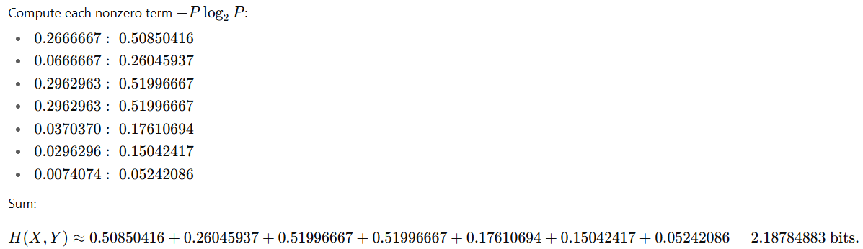

Slide 22
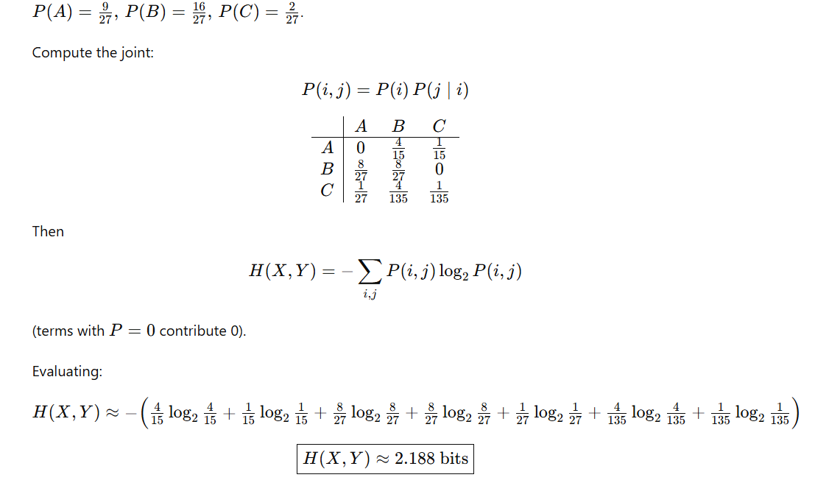

Slide 23
BSC: Numerical (Assignment)

Slide 24
BSC: Numerical (Assignment)

Slide 25

Extension of a DMS
Consider blocks of symbols rather than individual symbols with each block consisting of n successive source symbols.
The resultant entropy is
$$H\left(P^{n}\right)=nH(P)$$

Slide 26
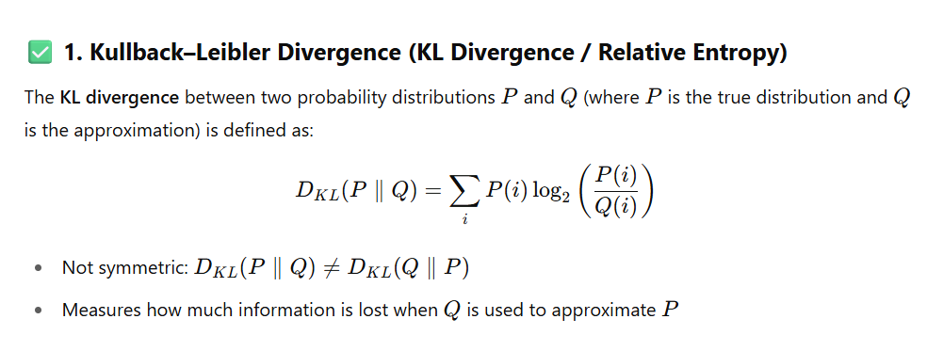
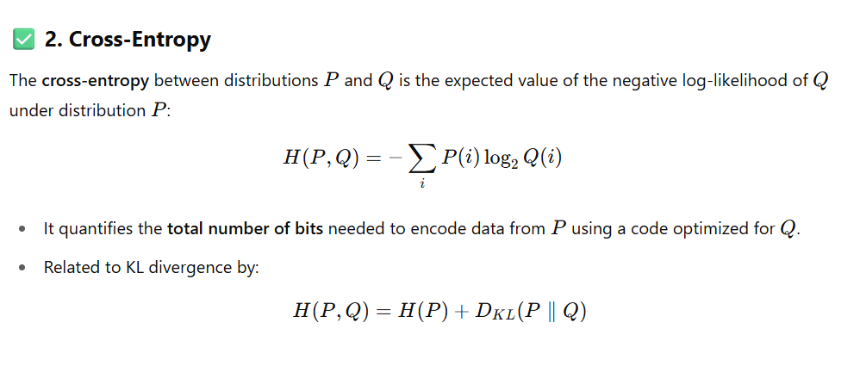

Slide 27
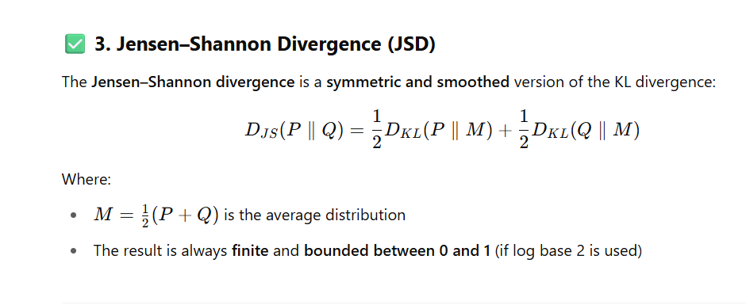

Slide 28
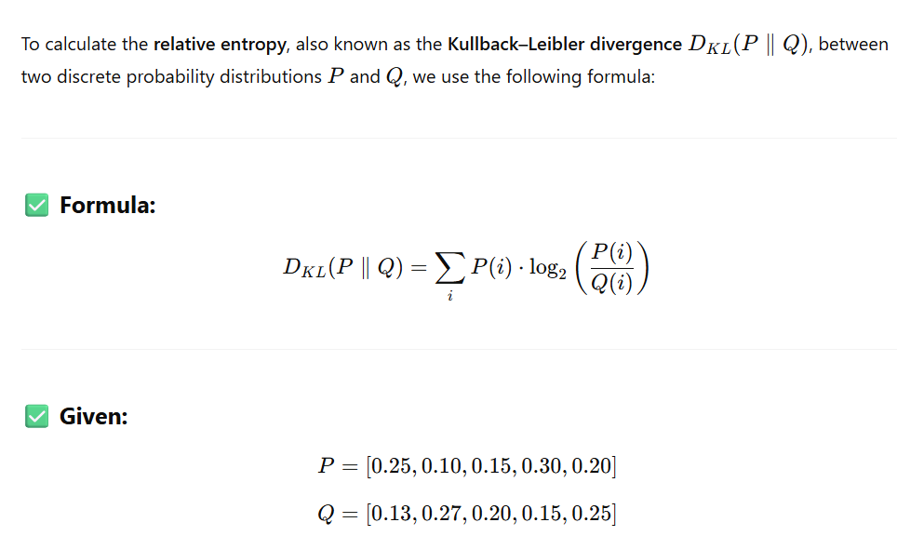
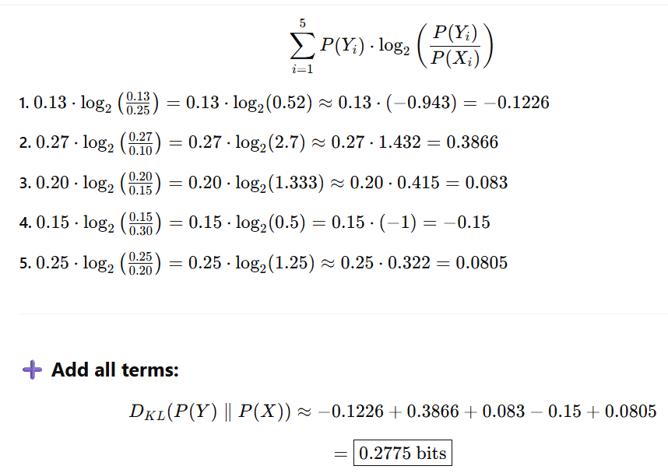
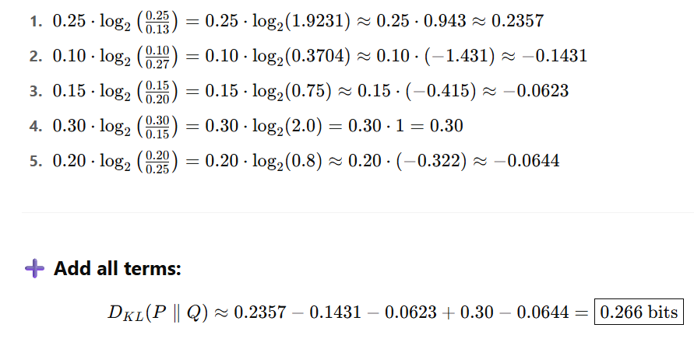
CALCULATE RELATIVE ENTROPY FOR (P)=[0.25,0.10,0.15,0.30,0.20], (Q)=[0.13,0.27,0.20,0.15,0.25]
A) D(P||Q) B) D(Q||P)
B) D(Q||P)
A) D(P||Q)

Slide 29
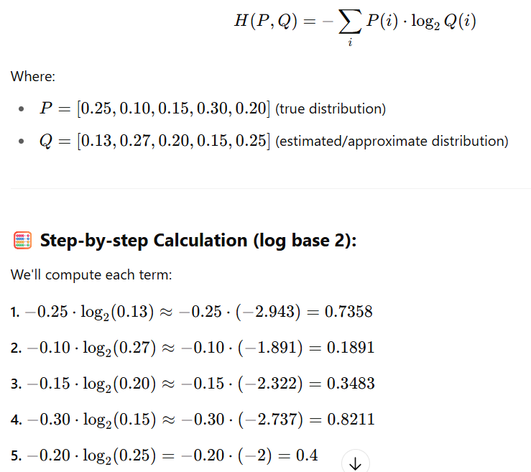
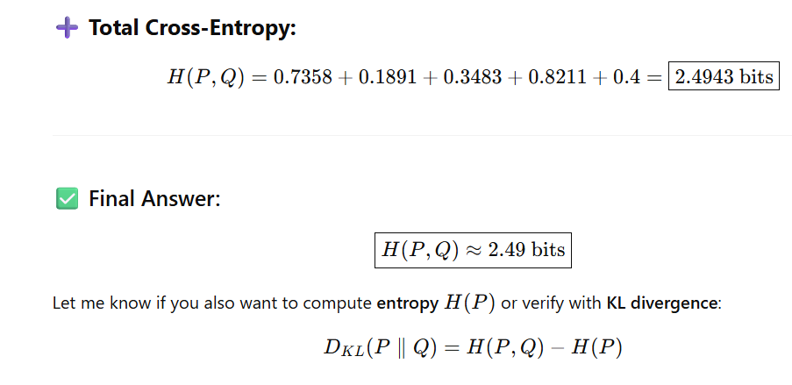
CALCULATE CROSS ENTROPY FOR P(X)=[0.25,0.10,0.15,0.30,0.20], P(Y)=[0.13,0.27,0.20,0.15,0.25]

Slide 30
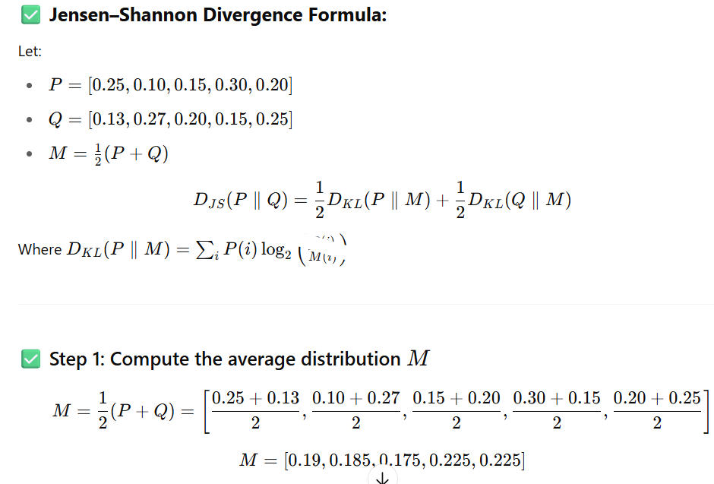
CALCULATE Jensen Shannon divergence FOR P(X)=[0.25,0.10,0.15,0.30,0.20], P(Y)=[0.13,0.27,0.20,0.15,0.25]

Slide 31
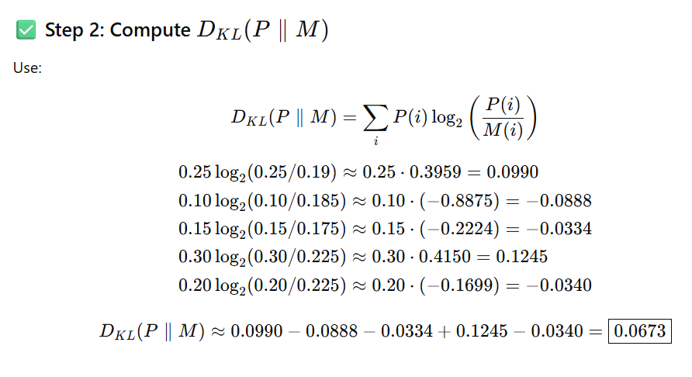
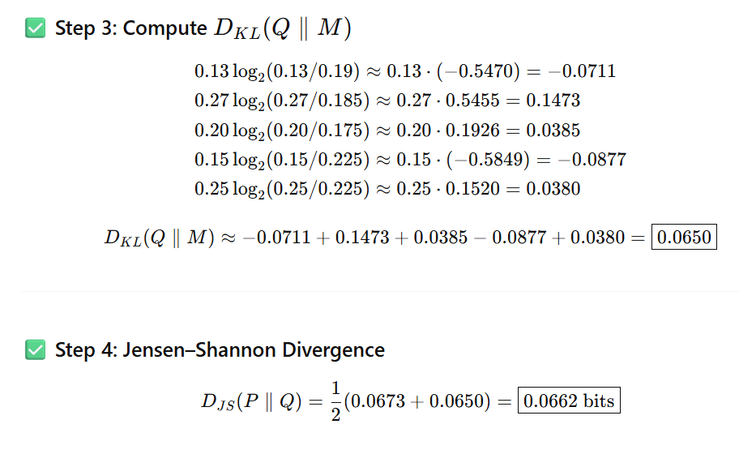

Slide 32
